Slide 1
Linux Program Development Practices

Slide 2
Training agenda
Compiling for debugging
Compiling with optimization
gprof – measuring program performance
Coverage testing with gcov

Slide 3
Compiling for debugging
int a (int *p);
int main (void)
{
int *p = 0; /* null pointer */
return a (p);
}
int a (int *p)
{
int y = *p;
return y;
}

Slide 4
Compiling for debugging
$ gcc -Wall -g null.c
Whenever the error message ‘core dumped’ is displayed, the operating system should produce a file called ‘core’ in the current directory.
Core files can be loaded into the GNU Debugger gdb with the following command:
$ gdb EXECUTABLE-FILE CORE-FILE

Slide 5
Compiling with optimization
GCC is an optimizing compiler. It provides a wide range of options which aim to increase the speed, or reduce the size, of the executable files it generates.
In general, different code must be generated for different processors, as they use incompatible assembly and machine languages. Each type of processor also has its own characteristics
Furthermore, different amounts of time are needed for different instructions, depending on how they are ordered.

Slide 6
Source-level optimization
There are many source-level optimization techniques —this section describes two common types:
common subexpression elimination
function inlining.

Slide 7
Common subexpression elimination
One method of source-level optimization which is easy to understand involves computing an expression in the source code with fewer instructions, by reusing already-computed results.
Example:
x = cos(v)*(1+sin(u/2)) + sin(w)*(1-sin(u/2))
t = sin(u/2)
x = cos(v)*(1+t) + sin(w)*(1-t)
Common subexpression elimination is powerful, because it simultaneously increases the speed and reduces the size of the code.

Slide 8
Function inlining
Function inlining eliminates this overhead by replacing calls to a function by the code of the function itself (known as placing the code in-line).
double sq (double x) {
return x * x;
}
for (i = 0; i < 1000000; i++) {
sum += sq (i + 0.5);
}

Slide 9
Function inlining
Optimization with inlining replaces the inner loop of the program with the body of the function, giving the following code:
for (i = 0; i < 1000000; i++)
{
double t = (i + 0.5); /* temporary variable */
sum += t * t;
}
GCC selects functions for inlining using a number of heuristics, such as the function being suitably small.

Slide 10
Speed-space tradeoffs
Loop unrolling
Scheduling

Slide 11
Loop unrolling
This form of optimization increases the speed of loops by eliminating the “end of loop” condition on each iteration.
for (i = 0; i < 8; i++)
{
y[i] = i;
}
y[0] = 0; y[1] = 1; y[2] = 2;
y[3] = 3; y[4] = 4; y[5] = 5;
y[6] = 6; y[7] = 7;

Slide 12
Loop unrolling
This form of the code does not require any tests, and executes at maximum speed. Since each assignment is independent, it also allows the compiler to use parallelism on processors that support it. Loop unrolling is an optimization that increases the speed of the resulting executable but also generally increases its size (unless the loop is very short, with only one or two iterations, for example).
Loop unrolling is also possible when the upper bound of the loop is unknown, provided the start and end conditions are handled correctly.

Slide 13
Loop unrolling
for (i = 0; i < (n % 2); i++) {
y[i] = i;
}
/* no initializer */
for ( ; i + 1 < n; i += 2) {
y[i] = i;
y[i+1] = i+1;
}
The assignments in the second loop can be parallelized, and the overall number of tests is reduced by a factor of 2 (approximately).
Higher factors can be achieved by unrolling more assignments inside the loop, at the cost of greater code size.

Slide 14
Scheduling
The lowest level of optimization is scheduling, in which the compiler determines the best ordering of individual instructions. Most CPUs allow one or more new instructions to start executing before others have finished. Many CPUs also support pipelining, where multiple instructions execute in parallel on the same CPU.
When scheduling is enabled, instructions must be arranged so that their results become available to later instructions at the right time, and to allow for maximum parallel execution. Scheduling improves the speed of an executable without increasing its size, but requires additional memory and time in the compilation process itself (due to its complexity).

Slide 15
Optimization levels
In order to
control compilation-time and compiler memory usage
the trade-offs between speed
space for the resulting executable
GCC provides a range of general optimization levels, numbered from 0–3
An optimization level is chosen with the command line option ‘-OLEVEL’, where LEVEL is a number from 0 to 3.

Slide 16
Optimization levels
‘-O0’ or no ‘-O’ option (default)
At this optimization level GCC does not perform any optimization and compiles the source code in the most straightforward way possible.
Each command in the source code is converted directly to the corresponding instructions in the executable file, without rearrangement.
This is the best option to use when debugging a program.

Slide 17
Optimization levels
‘-O1’ or ‘-O’
This level turns on the most common forms of optimization that do not require any speed-space tradeoffs. With this option the resulting executables should be smaller and faster than with ‘-O0’.
The more expensive optimizations, such as instruction scheduling, are not used at this level.
Compiling with the option ‘-O1’ can often take less time than compiling with ‘-O0’, due to the reduced amounts of data that need to be processed after simple optimizations.

Slide 18
Optimization levels
‘-O2’
This option turns on further optimizations, in addition to those used by ‘-O1’.
These additional optimizations include instruction scheduling.
Only optimizations that do not require any speed-space tradeoffs are used, so the executable should not increase in size.
The compiler will take longer to compile programs and require more memory than with ‘-O1’.

Slide 19
Optimization levels
This option is generally the best choice for deployment of a program, because it provides maximum optimization without increasing the executable size.
It is the default optimization level for releases of GNU packages.

Slide 20
Optimization levels
‘-O3’
This option turns on more expensive optimizations, such as function inlining, in addition to all the optimizations of the lower levels ‘-O2’ and ‘-O1’.
The ‘-O3’ optimization level may increase the speed of the resulting executable, but can also increase its size.
Under some circumstances where these optimizations are not favorable, this option might actually make a program slower.

Slide 21
Optimization levels
‘-funroll-loops’
This option turns on loop-unrolling, and is independent of the other optimization options.
It will increase the size of an executable. Whether or not this option produces a beneficial result has to be examined on a case-by-case basis.

Slide 22
Optimization levels
‘-Os’
This option selects optimizations which reduce the size of an executable. The aim of this option is to produce the smallest possible executable, for systems constrained by memory or disk space.
In some cases a smaller executable will also run faster, due to better cache usage.

Slide 23
Optimization and debugging
With GCC it is possible to use optimization in combination with the debugging option ‘-g’. Many other compilers do not allow this.
When using debugging and optimization together, the internal rearrangements carried out by the optimizer can make it difficult to see what is going on when examining an optimized program in the debugger. For example, temporary variables are often eliminated, and the ordering of statements may be changed.
However, when a program crashes unexpectedly, any debugging information is better than none—so the use of ‘-g’ is recommended for optimized programs, both for development and deployment. The debugging option ‘-g’ is enabled by default for releases of GNU packages, together with the optimization option ‘-O2’.

Slide 24
Optimization & compiler warnings
When optimization is turned on, GCC can produce additional warnings that do not appear when compiling without optimization.

Slide 25
Using the profiler gprof 1/3
The GNU profiler gprof is a useful tool for measuring the performance of a program—it records the number of calls to each function and the amount of time spent there, on a per-function basis.
The source file ‘collatz.c’ contains three functions: main, nseq and step:
$ gcc -Wall -c -pg collatz.c
$ gcc -Wall -pg collatz.o

Slide 26
Using the profiler gprof 2/3
This creates an instrumented executable which contains additional instructions that record the time spent in each function.
If the program consists of more than one source file then the ‘-pg’ option should be used when compiling each source file, and used again when linking the object files to create the final executable (as shown above).
While running the instrumented executable, profiling data is silently written to a file ‘gmon.out’ in the current directory. It can be analyzed with gprof by giving the name of the executable as an argument:
$ gprof a.out

Slide 27
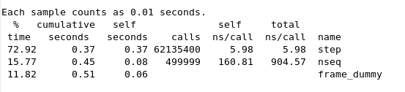
Using the profiler gprof 3/3

Slide 28
Coverage testing with gcov 1/5
The GNU coverage testing tool gcov analyses the number of times eachline of a program is executed during a run.
This makes it possible tofind areas of the code which are not used, or which are not exercised in testing.

Slide 29
Coverage testing with gcov 2/5
#include <stdio.h>
int main (void)
{
int i;
for (i = 1; i < 10; i++) {
if (i % 3 == 0)
printf ("%d is divisible by 3\n", i);
if (i % 11 == 0)
printf ("%d is divisible by 11\n", i);
}
return 0;
}

Slide 30
Coverage testing with gcov 3/5
$ gcc -Wall -fprofile-arcs -ftest-coverage cov.c
The option ‘-ftest-coverage’ adds instructions for counting the number of times individual lines are executed
‘-fprofile-arcs’ incorporates instrumentation code for each branch of the program.
The data from the run is written to several files with the extensions ‘.bb’ ‘.bbg’ and ‘.da’ respectively in the current directory.

Slide 31
Coverage testing with gcov 4/5
$ gcov cov.c ➔ Creating cov.c.gcov
The gcov command produces an annotated version of the original source file, with the file extension ‘.gcov’, containing counts of the number of times each line was executed
Lines which were not executed are marked with hashes ‘######’.

Slide 32
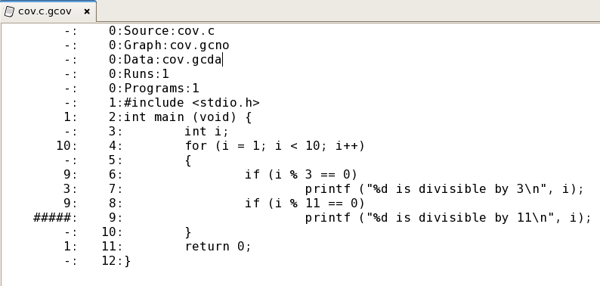
Coverage testing with gcov 5/5

Slide 33
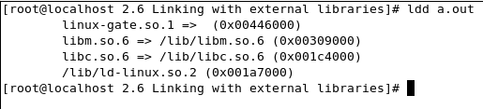
Finding dynamically linked libraries
The command ldd examines an executable and displays a list of the shared libraries that it needs.
$ gcc -Wall hello.c
$ ldd a.out
this program depends on the math library libm (shared library version 6)
in addition to the C library and dynamic loader library.

Slide 34
Finding dynamically linked libraries
this program depends on the math library libm (shared library version 6)
in addition to the C library and dynamic loader library.

Slide 35
Q & A

